Slide 1
Web Scraping with API
Ayushi Anil Shrivastava
NetID: tf2272

Slide 2
Why Web Scraping ?
Indispensable for analysts
If you need to analyze some trend, such as which product is more popular among which age group or which gender prefers what beauty products, you can get a web scraping service provider to help you obtain data that will help you conduct such an analysis, by gathering the data. This will not only help you analyze data and make good decisions, it will also help you gain valuable business insights, which will help you in the long run.
2. Speed
In this age, where we need everything fast, be it food or car, it makes no sense to hire someone to manually scrape web-pages. It would be costly, prone to errors and most importantly, would take a ton of time. In fact, the rate at which data is growing, a scraper can scrape as much data in a day, as a man could have in a year. Moreover, there is no need to worry about any fatigue. You can keep the server up and running the scraper all the time.

Slide 3
Why Web Scraping?
3. Accuracy
In case of web scraping, data is the product that you gain, using a service. This is the data, that you will leverage, to grow your business. In case the data contains errors, you will be facing the wrath of dirty data. However, today if you are using a good web scraping service, you can count on accuracy levels, that even your best employee can’t guarantee.
4. Tracking latest trends
Dealing with communication or media? For the most part, you need to have men on the ground, but then, you can’t have men EVERYWHERE! That’s where data scraping comes in and serves as a “story gatherer” for you, getting you what’s hot and happening in the various circles in the industry, and what people are talking about.

Slide 4
What is an API?
API stands for Application Programming Interface, i.e. API is the way for an application to interact with certain system/application/library/etc. For example, there are API's for OS (WinAPI), API's for other applications (like databases) and for specific libraries (for example, image processing), etc
An application program interface (API) is a set of routines, protocols, and tools for building software applications. Basically, an API specifies how software components should interact. Additionally, APIs are used when programming graphical user interface (GUI) components.
An application programming interface key (API key) is a code passed in by computer programs calling an application programming interface (API) to identify the calling program, its developer, or its user to the Web site.
When an API endpoint is architecturally the point at which the API-consuming application is essentially decoupled from the service being consumed, it affords the API provider a significant amount of flexibility when it comes to providing its service.

Slide 5
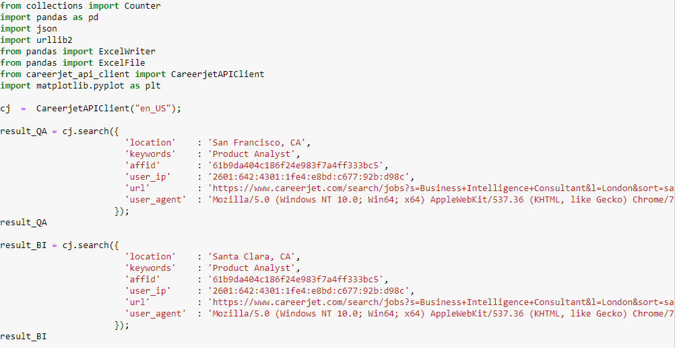
Implementation: Fetching Jobs in California

Slide 6
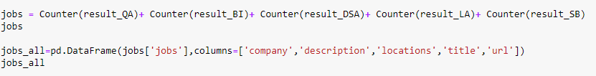
Integrating Jobs using Counter and storing in DataFrame:

Slide 7
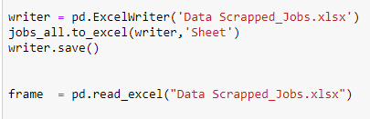
Writing all jobs in an Excel file and reading it:

Slide 8
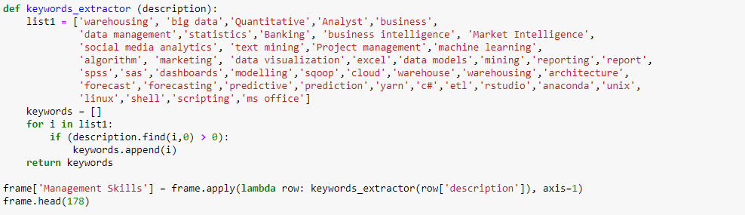
Keywords Extraction:

Slide 9
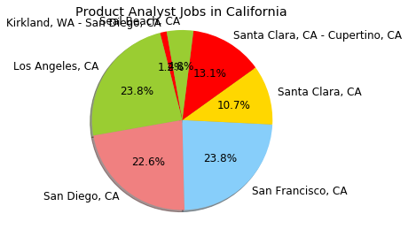
Visualization:

Slide 10
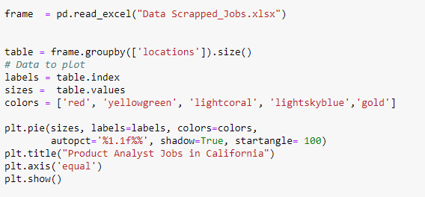
Code for Pie Chart:

Slide 11
Finding from Pie-Chart (Demand of Product Analyst Jobs):
As we can see, Pie-Chart is depicting Product Analyst jobs across California, USA.
It has been plotted considering 6 cities in California namely Santa Clara-Cupertino, Santa Clara, San Diego, San Francisco, Los Angeles and Seal Beach.
Los Angeles and San Francisco have the highest demand of Product Analyst jobs in California (23.8%) followed by San Diego with 22.6% jobs in California.
Santa Clara follows Santa Clara Cupertino with marginal difference of 2.4% demand difference.

Slide 12
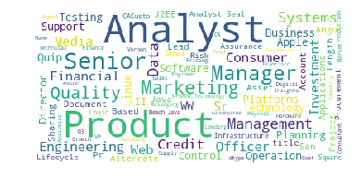
Text Mining (Title) :

Slide 13
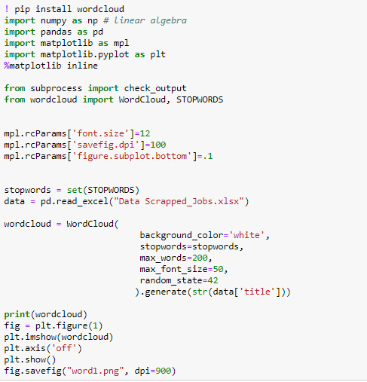
Code for Text Mining Plot:

Slide 14
Finding from Text Mining plot (Title):
Text mining, also referred to as text data mining, roughly equivalent to text analytics, is the process of deriving high-quality information from text.The overarching goal is, essentially, to turn text into data for analysis, via application of natural language processing (NLP) and analytical methods.
Text Mining plot describes the density of jobs for a particular title in USA.
As we can see from the plot of Text Mining, it is evident that job titles which are predominant in USA are that of Product Analyst, Manager, Marketing Management, Senior Data Analyst.

Slide 15

Thank You!!

